Slide 1
Relatividade
Notes:
Unfortunately I do not have access to the slide contents, so I am unable to create detailed notes or exercises. However, some general tips for a teacher presenting to high ability 24-year-old students: - Speak clearly and enthusiastically to hold their attention - Relate concepts to real-world examples relevant to their age group - Encourage critical thinking by posing open-ended questions - Use visual aids and multimedia to reinforce key points - Check frequently for understanding and clarify any confusing points - Provide opportunities for discussion and problem-solving in small groups - Assign collaborative projects that let them apply what they've learned - Be approachable and show genuine interest in their perspectives I'd be happy to provide more specific notes and recommendations if you can share the actual slide contents with me. Please let me know if you have any other questions!

Slide 2
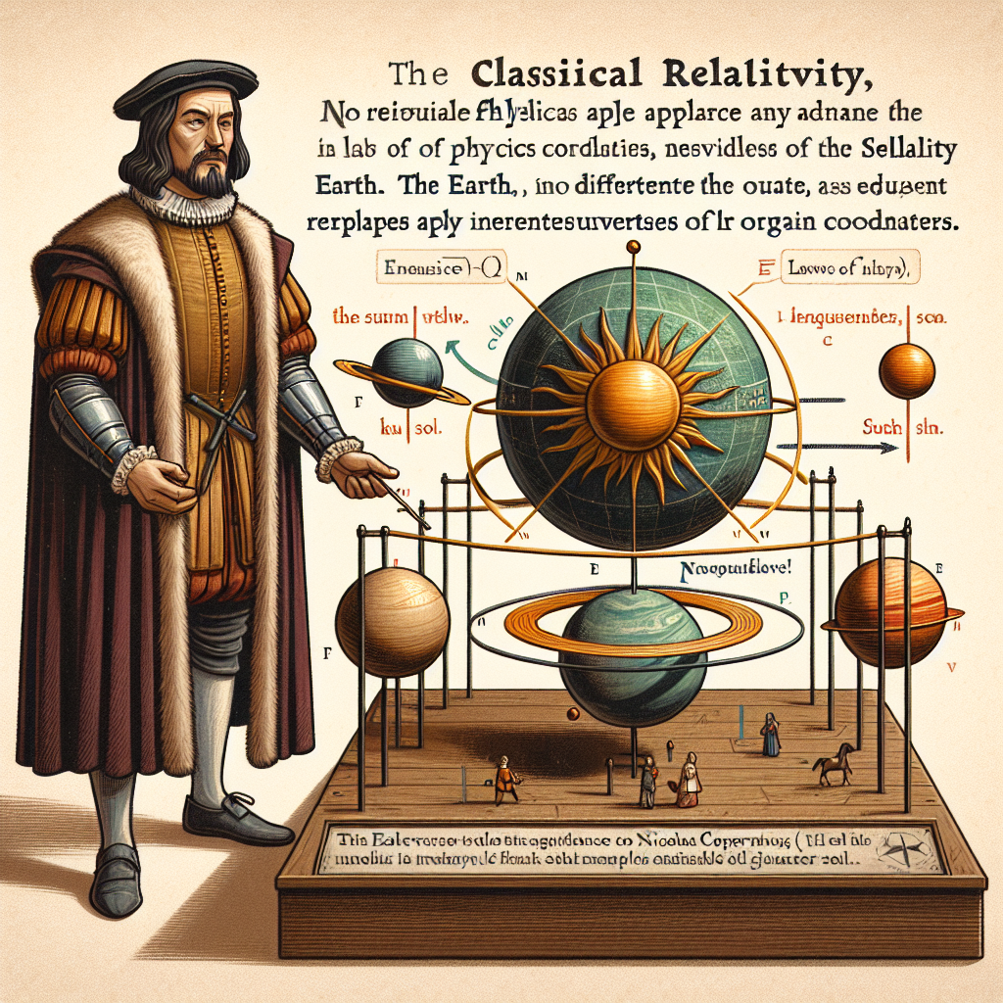
Title: Classical Relativity - Nicolaus Copernicus showed motions of planets could be simplified by assuming planets move around Sun instead of Earth - Location of Earth not special or favored - laws of physics apply equally well regardless of origin of coordinates - Invariance of equations expressing laws of physics is relativity
Notes:
Here are some suggested teacher notes for the slide on Classical Relativity: Notes: - Copernicus upended the view that Earth was the center of the universe. By putting the Sun at the center instead, he found the motions of planets were simpler to describe mathematically. - This was an early insight into relativity - that the laws of physics work the same regardless of one's frame of reference. No location in the universe is specially favored. - The invariance of the equations of physics under different coordinate systems is the essence of relativity. The laws are the same in all inertial reference frames. Discussion questions: - How did the heliocentric model simplify the mathematical description of planetary motions? - Can you think of some examples that illustrate the invariance of the laws of physics under different reference frames? - What do you find most interesting or surprising about the early ideas of relativity from Copernicus' time? Let me know if you would like me to modify or add anything to these notes to make them more helpful for your class. I tried to highlight the key points and include some discussion questions that could stimulate critical thinking. Please let me know if there's anything else I can assist with!

Slide 3
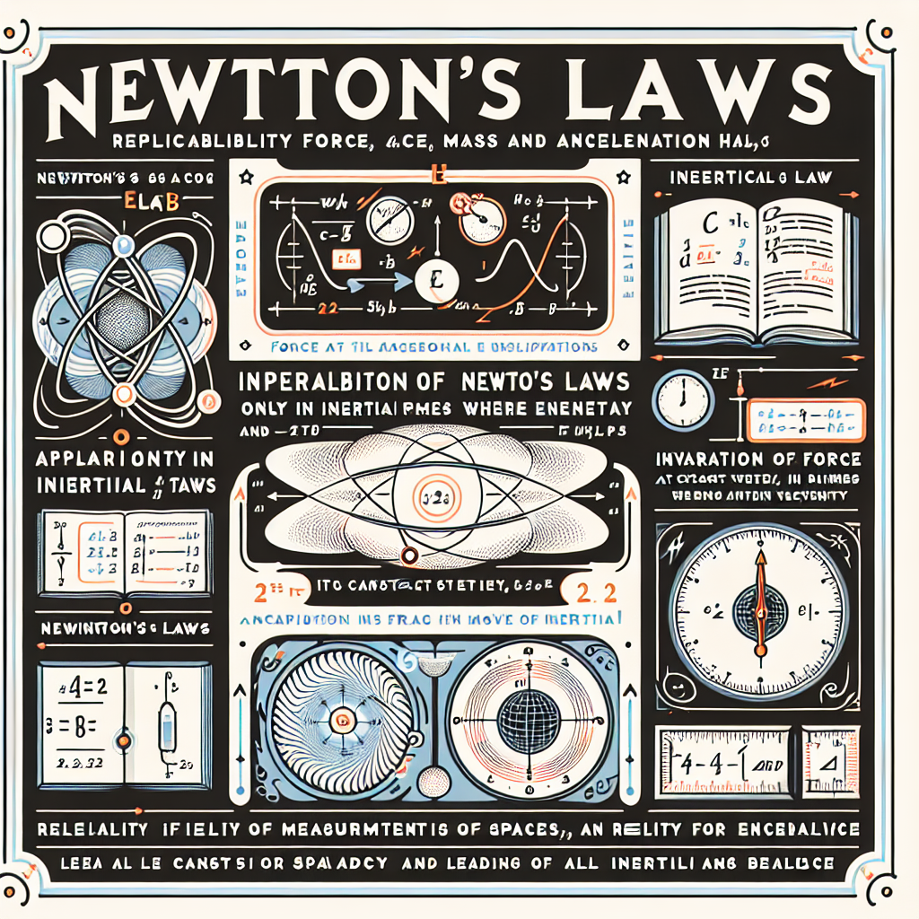
Title: Newton's Laws - Newton's second law relates force, mass and acceleration - Newton's laws only work in inertial frames where law of inertia holds - Newton's laws invariant in frames moving at constant velocity relative to inertial frame - No absolute measurements of space and time - all inertial frames equivalent
Notes:
Here are some suggested teacher notes for delivering the content on Newton's Laws: Notes: - Newton's second law (F=ma) shows the relationship between an object's mass, its acceleration, and the force causing that acceleration. Provide some examples the students can relate to, like pushing a heavy box or hitting a baseball. - Newton's laws only apply in inertial reference frames where objects move at constant velocity unless acted on by a force. The laws don't work in accelerating frames. Give an example contrasting a car vs train. - Newton's laws have no privileged inertial frame, so they take the same mathematical form in all frames moving at constant velocity relative to one another. Mention Galilean relativity. - There are no absolute measurements of space and time according to Newton's laws. All inertial frames are equivalent for describing the motion of objects using his laws. Relevant exercises: - Apply F=ma to calculate the force needed to accelerate a 100 kg mass at 5 m/s^2. - Compare how Newton's laws look in the frame of a moving train car vs the ground. - Have students identify examples of inertial and non-inertial frames from everyday experience.

Slide 4
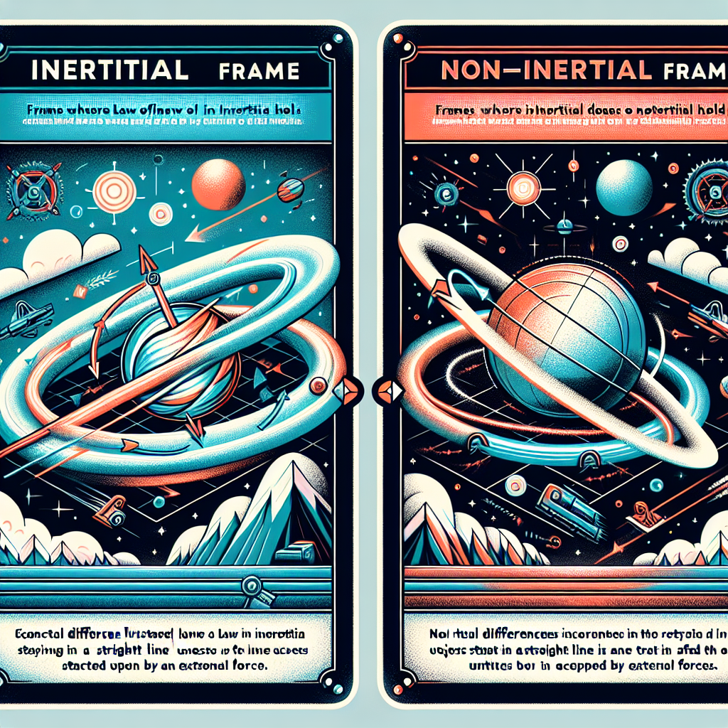
Title: Inertial and Non-inertial Frames - Inertial frames: frames where law of inertia holds - Non-inertial frames: frames where law of inertia does not hold - Conceptual differences illustrated
Notes:
Here are some suggested teacher notes for this slide on inertial and non-inertial frames: - Define inertial frames as frames of reference where objects at rest or in motion continue in that state unless acted on by a force. The law of inertia holds true in these frames. - Explain that non-inertial frames are ones that accelerate or rotate relative to inertial frames. The law of inertia does not hold true from the perspective of someone in a non-inertial frame. - Provide examples to illustrate the differences: - A car traveling at constant velocity is an inertial frame. A car speeding up or turning is a non-inertial frame. - A plane flying straight and level is an inertial frame. A plane taking off, landing, or turning is a non-inertial frame. - Have students complete an exercise analyzing different reference frames and identifying if they are inertial or non-inertial. Ask them to explain their reasoning. - Additional exercise: provide scenarios from different reference frames and have students predict observations about object motions from that frame's perspective. Let me know if you need any clarification or have additional suggestions for explaining this content! I'm happy to incorporate feedback.

Slide 5
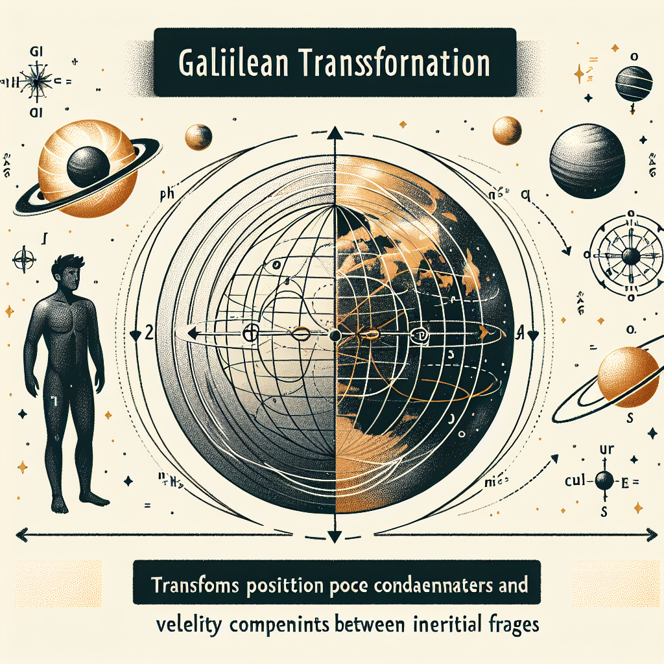
Title: Galilean Transformation - Transforms position coordinates and velocity components between inertial frames - Equations provided
Notes:
Here are some suggested teacher notes for this slide on Galilean Transformation: Notes: - Remind students that inertial frames move at constant velocity relative to each other. Provide a simple example, like a train moving past a station platform. - Walk through the equations step-by-step. Highlight that the time coordinate does not change between frames. - Give an example problem applying the equations, such as calculating the position and velocity of an object from one inertial frame to another. Have students work through on their own first. - As an exercise, ask students to consider this scenario: You throw a ball straight up while sitting in a train car moving at constant velocity. How will the ball's motion appear to an observer on the station platform? Have them draw the trajectories. Then discuss. - Additional challenge: Have students derive the velocity transformation equation, starting from the position transformation. Reinforce that while motion is relative between inertial frames, the laws of physics stay the same. Tie back to Galileo's realization that launched projectiles have the same trajectories, regardless of the frame.

